Slide 1
CLASS 01: INTRO TO PYTHON

Slide 2
PYTHON INSTALLATION
https://www.digitalocean.com/community/tutorials/install-python-windows-10

Slide 3
Why Python?
Easy to learn
No complexity
High level language
Interpreted language
Not fastest language

Slide 4
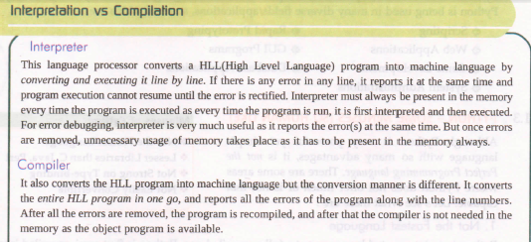

Slide 5
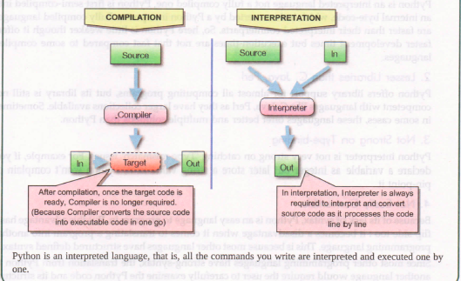

Slide 6
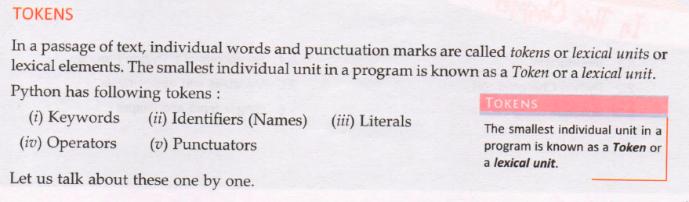
BUILDING BLOCKS OF PYTHON

Slide 7
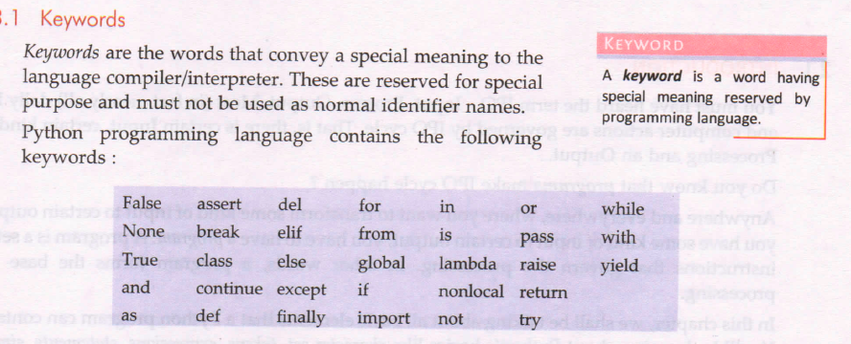

Slide 8
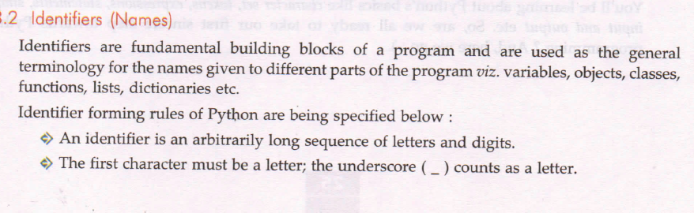

Slide 9
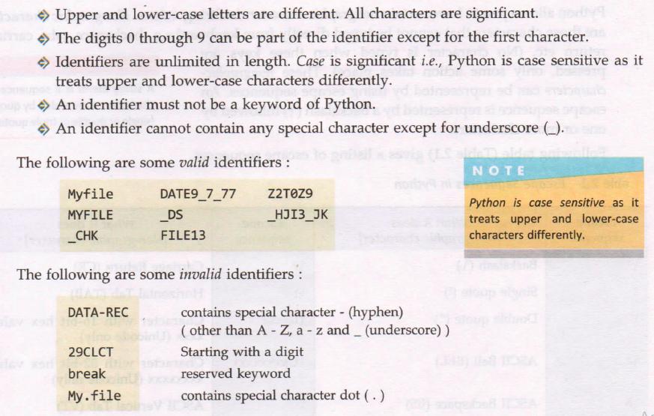

Slide 10
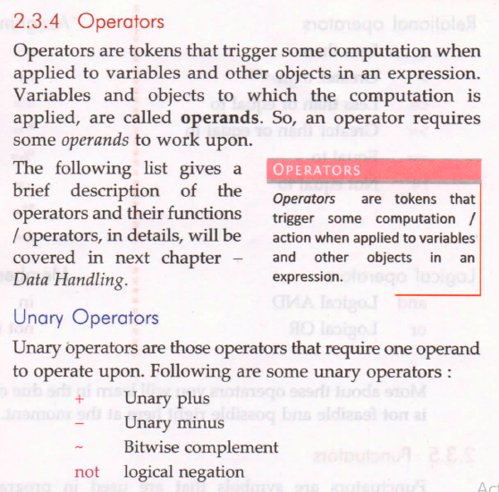

Slide 11
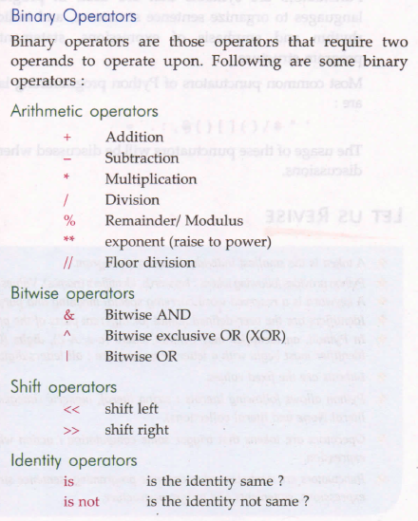

Slide 12
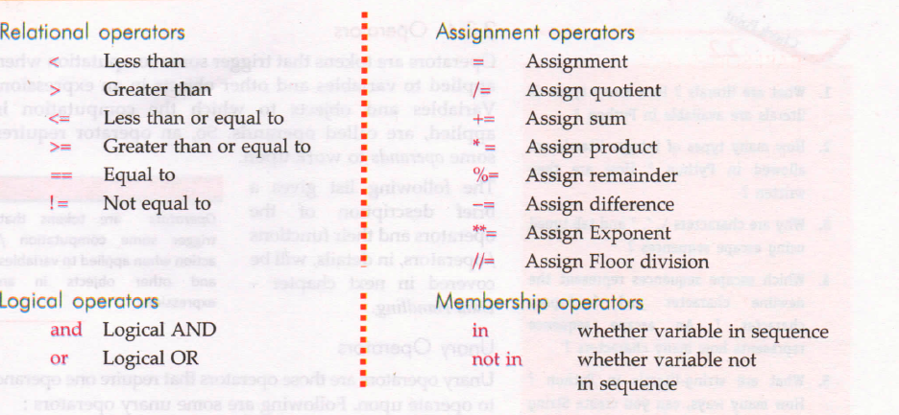

Slide 13
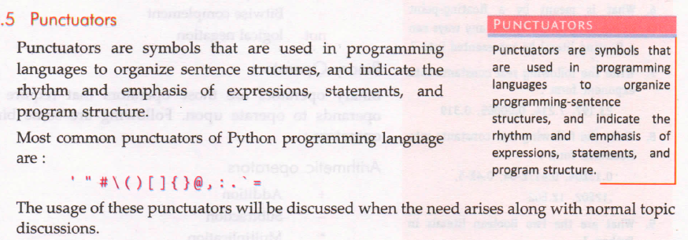

Slide 14
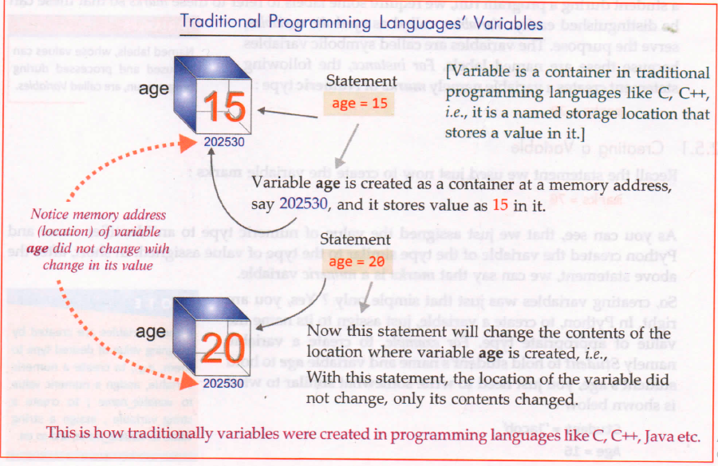
PYTHON FUNCTIONING

Slide 15
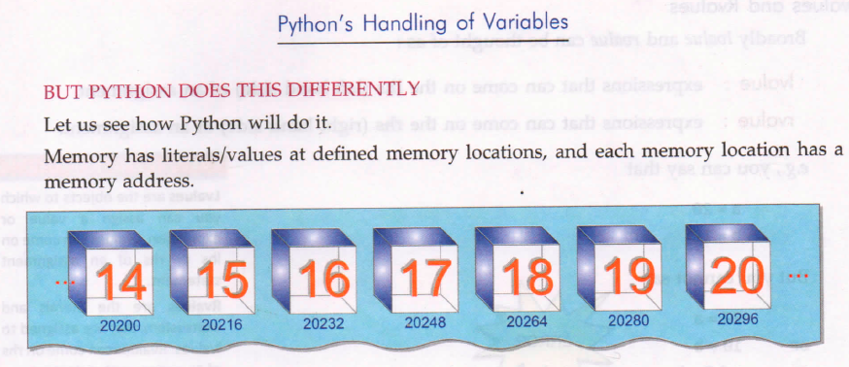

Slide 16
